Slide 1
E Commerce Product Delivery Prediction

Slide 2
Agenda
Problem Statement
Dataset Overview
Methodology
Exploratory Data Analysis & Preprocessing
Predictive Model and Evaluation Metrics
Dashboard Visualization
Deployment
Conclusion
Thank You

Slide 3
Problem Statement
The goal of this project is to predict whether a product will be delivered on time (Yes, or No) using historical data and relevant features.
This is the binary classification problem.
We want to identify the factor that influence on time delivery and provide actionable insights for improving delivery reliability. The way it’s straight forward and to the point

Slide 4
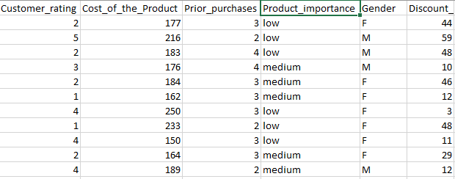
Dataset Overview
I’m working with a dataset of around 11,000 rows and 12 columns, which include important features such as the Mode_of _shipment, product_ importance, customer_rating, and cost_of_product.
The comprehensive dataset serve as the foundation for my analysis and modeling, allowing us to uncover insights and predict on-time delivery effectively.

Slide 5
Methodology
In methodology, I followed a structured approach.
I began by cleaning the raw data to ensure accuracy and consistency. After that, I conducted Exploratory Data Analysis (EDA) to identify patterns and insights.
Next I performed Data Preprocessing to prepare the dataset for modeling.
Then I applied a Logistic Regression to predict On-Time Delivery and evaluate the model’s Performance using standard metrics.
Then I created Dashboard Visualization to present my finding clearly.
Finally, I deployed the app using Streamlit.

Slide 6
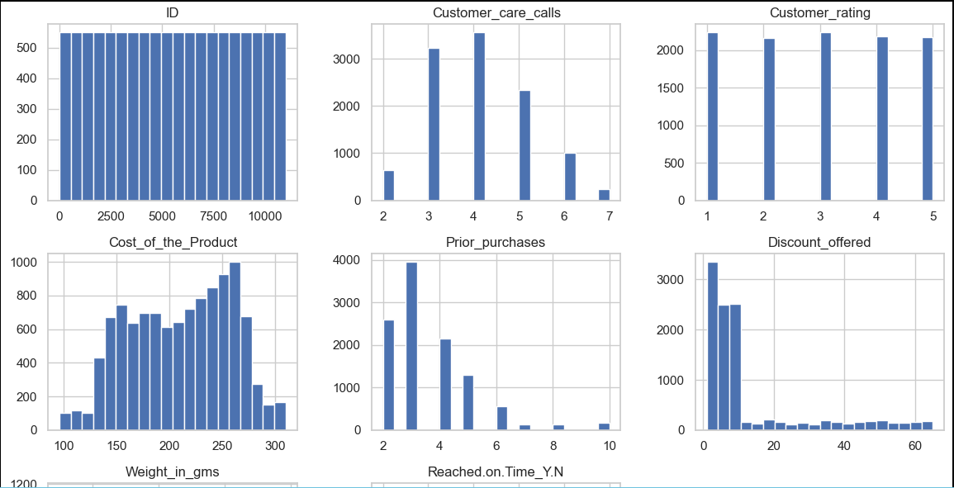
Exploratory Data Analysis (EDA)
In Exploratory Data Analysis, I started by using info() and describe() to get a summary of the dataset and understand it’s structure.
I analyze the shape of the data and used value counts, sup title and count plots to visualize the distribution of the target variable and other categorical features.
I examine the numerical feature distributions to identify skewness and performed correlation analysis to identify features that may influence delivery performance.

Slide 7
Preprocessing
Preprocessing Steps:
Missing Values Imputation: Handled missing data using appropriate imputation strategies to ensure data completeness.
Feature Separation: Separated the target variable from the input features to prepare for modeling.
Categorical Encoding: Encoded categorical features using One-Hot-Encoding to convert them into a numerical format.
Feature Scaling: Applied standard scaling to numerical features to ensure they’re on a consistent scale.
Outlier Treatment: Identified and managed outliers to maintain data integrity.
Train-Test Split: Performed a stratified train-test split to preserve the class distribution in both sets.

Slide 8
Predictive Model and Evaluation Metrics
In this project, a unified preprocessing pipeline is implemented to ensure consistent data transformation during both training and evaluation. Multiple machine learning models are trained including Logistic Regression, K-Nearest Neighbors (KNN), Decision Tree, Random Forest, Gradient Boosting, and XGBoost.
Each model is evaluated using standard classification metrics such as Accuracy, Confusion Matrix, Classification Report, and ROC-AUC score. Model performance is further analyzed using , visualizations including Confusion Matrix Heatmaps and ROC-AUC Curve, to understand prediction quality and class separation.
Among all the models, Gradient Boosting achieved the best performance with the highest Accuracy and ROC-AUC score, making it the most reliable model for predicting on-time delivery. Therefor, Gradient Boosting was selected as the final best model and saved for deployment.
Feature Importance: Feature importance was derived from tree-based models to understand key factors influencing on-time delivery performance.

Slide 9
Dashboard Visualization
A Power BI dashboard is developed to provide an interactive view of delivery performance and key operational metrics for the e-commerce product delivery prediction project. The dashboard enables quick monitoring of shipment mode, warehouse efficiency, customer behavior, product importance, and on-time delivery trends, supporting data-driven decision-making.
Key Insights from Dashboard
On-time deliveries exceed late deliveries, indicating overall strong delivery performance across the network.
Shipment mode significantly impacts delivery outcomes; Ship mode handles the highest shipment volume, while Flight and Road contribute smaller but comparable volumes.
Warehouse F outperforms other warehouses, showing the highest shipment weight and better on-time delivery contribution.
Higher customer care ratings are associated with better on-time delivery rates, highlighting the importance of service quality.

Slide 10
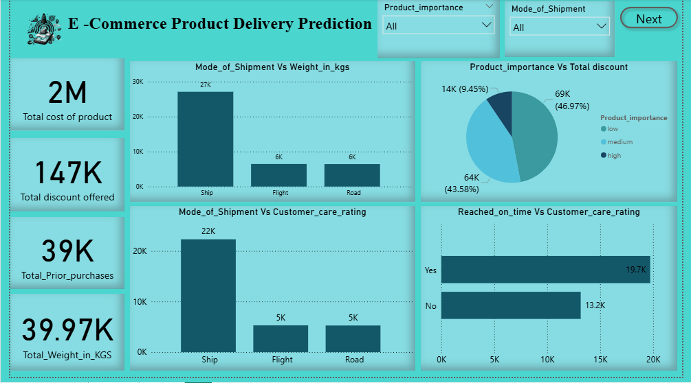
Power BI Presentation

Slide 11
Deployment
The final Gradient Boosting model was deployed using a Streamlit web application to enable real-time prediction of on-time delivery. The application allows users to input relevant product, shipment, and customer details and instantly receive delivery predictions. This deployment makes the model accessible for practical business use and supports operational decision-making.
Deployment Insights:
The deployed model classifies deliveries into low delay risk (≥45%), moderate delay risk (35%–44%), and high delay risk(<35%) risk categories, enabling proactive monitoring and early intervention.

Slide 12
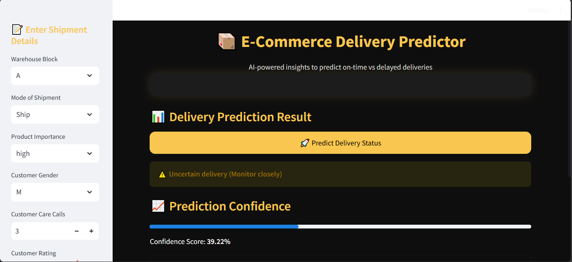
Streamlit – Web Page
Click here to visit app

Slide 13
Conclusion
This project successfully predicted on-time delivery for e-commerce products using machine learning and data visualization. Multiple models is evaluated, with Gradient Boosting achieving the best performance. The Power BI dashboard and Streamlit deployment transformed model outputs into actionable insights, enabling data-driven decisions to improve delivery efficiency, customer satisfaction, and operational performance.

Slide 14
Thank You!

